Slide 1
Economic analysis of new product development
The issue of the market introduction of DUCK liqueur

Slide 2
PRODUCT RANGE EXPANSION
Our successful products are two types of beer, light and dark beer. It's time to hit the market with a new product!

Slide 3
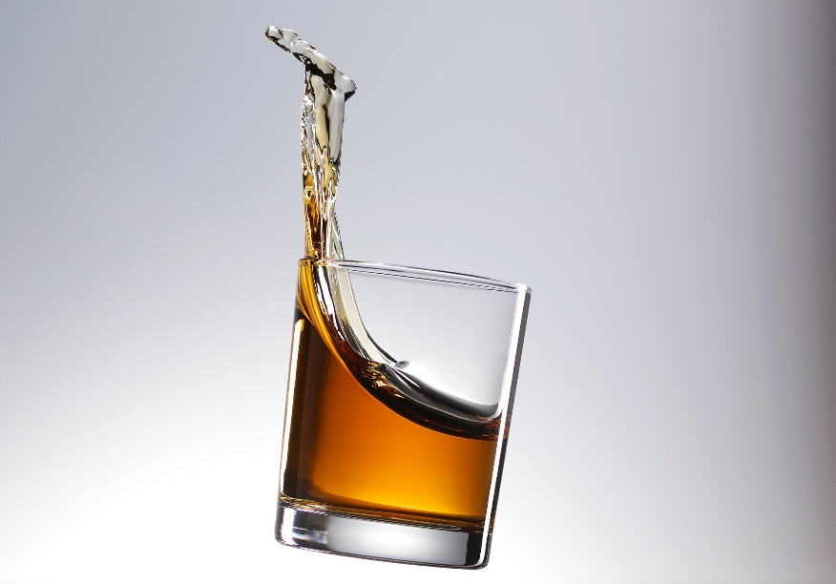
DUCK's malt liqueur
Our product developers have produced a new product with a special tasteful of 40% alcohol, the DUCK's malt liqueur, from the raw materials used for brewing!
Our market researchers tested the consumer reception at store stalls, it was favorable!
The new product is ready for market launch

Slide 4
STEPS FOR INTRODUCING THE PRODUCT
Administrative steps: patenting, licensing
Development steps: product design for bottle, for logo
Investment steps: construction of a new factory hall, a new warehouse building
Market research steps: definition of unpacking and wrapping types, promotion strategy
Human resource issues: appointment of new sector leaders, training of skilled workers

Slide 5
MANAGEMENT ISSUES
What improvements need to be made?
2. What should be the optimal production program?
3. What permits are required to obtain from the authorities in order to start series production of the liqueur?
4. How much extra malt should be procured to maximize total revenue?
5. What should be the promotion strategy?
6. What should the new product look like?

Slide 6
THE COMMISSION 'S REPLIES
What improvements need to be made?
Construction of a factory hall and warehouse
2. What should be the optimal production program? Can be designed with linear programming
3. What permits are required to obtain from the authorities in order to start series production of the liqueur? Standard product launch issues, no special relevance
4. How much extra malt should be procured to maximize total revenue? It can be calculated by linear programming
5. What should be the promotion strategy? Outsourcing to an advertising agency with a procurement tender
6. What should the new product look like? Outsourcing to a product design studio with a tender

Slide 7
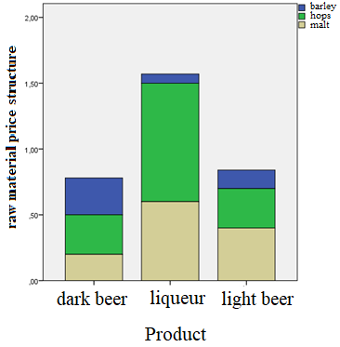
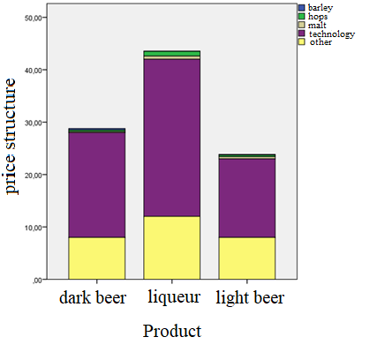
DETERMINATION OF THE OPTIMAL PRODUCTION PROGRAM
The price distributions of the products must be taken into account when designing:
The figure on the left can be used to limit the stock of raw materials, the figure on the right can be used to specify the production price.
It can be seen that raw material prices are not significant when giving the market price. Price reductions are best achieved by cutting technology costs.

Slide 8
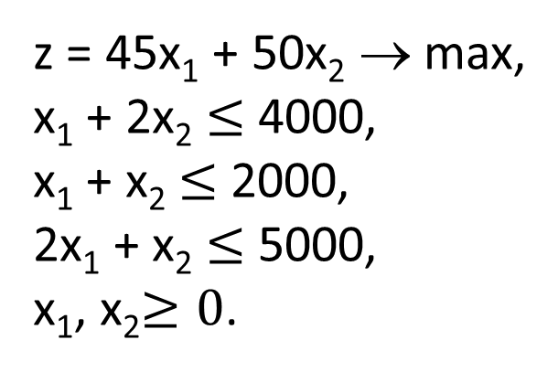
DETERMINATION OF THE OPTIMAL PRODUCTION PROGRAM
Taking into account constraint conditions, the modeling of the current production plan by the simplex method:
z = 45x₁ + 50x₂ → max,
x₁ + 2x₂ $≤$ 4000,
x₁ + x₂ $≤$ 2000,
2x₁ + x₂ $≤$ 5000,
x₁, x₂$≥0$.
z indicates revenue associated to the program.

Slide 9
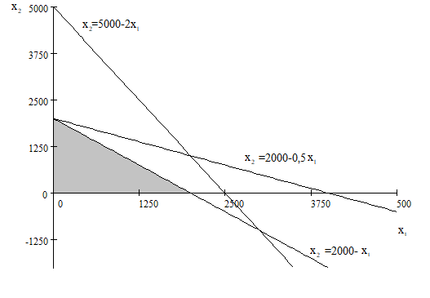
DETERMINATION OF THE OPTIMAL PRODUCTION PROGRAM
The gray area indicates the set of allowed solutions. From this, the solution that provides the maximum must be selected.
Only three vertices can be considered as a solution, of which (0, 2000) solves the maximum. It gives a surprising result.
In terms of revenue, the factory would be better off making only dark beer!

Slide 10
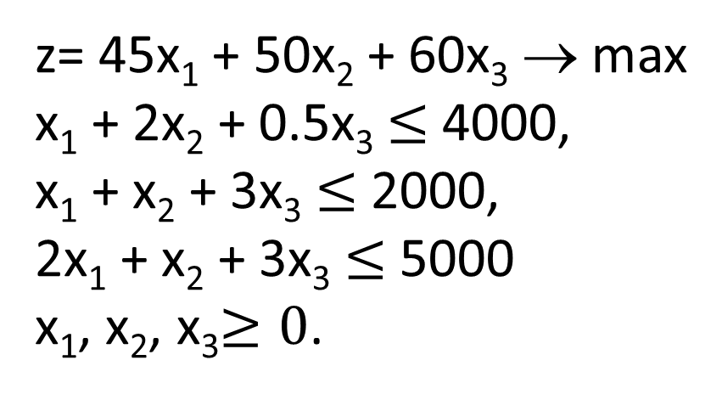
DETERMINATION OF THE OPTIMAL PRODUCTION PROGRAM
The model for three products:
z= 45x₁ + 50x₂ + 60x₃ → max
x₁ + 2x₂ + 0.5x₃ $≤$ 4000,
x₁ + x₂ + 3x₃ $≤$ 2000,
2x₁ + x₂ + 3x₃ $≤$ 5000
x₁, x₂, x₃$≥0$.
Solved by the simplex method, even with the current stock of raw materials, we get that (0, 2000, 0) the optimal plan, ie the highest revenue can be achieved only by producing dark beer!

Slide 11
CONCLUSIONS
For the time being, it is not worthwhile to start series production of the liqueur
Trial production and developments must be started
If warehouses are filled with raw materials, other restrictive conditions may be imposed
Lower and upper limits should be applied to the quantity of products in the model
When maximizing revenue, you need to move on to maximizing profits

Slide 12
Thank You for Your Attention!

